Slide 1
Demand Analysis Over a Distribution of Consumer Types
Bill Polley
Associate Professor of Economics
Western Illinois University
October 16, 2019

Slide 2
Outline
A little bit of supply and demand
What does a demand curve really look like?
Heterogeneous consumers—implications for demand theory
How does price respond to innovation?
Data analytics approach to pricing

Slide 3
If you have taken a course in economics, then you have seen this…
P
S
D
Q

Slide 4
In an intro economics course, we might even use simple algebra…
P
50
P = 50 – 0.5 Q
Or
Q = 100 – 2 P
D
100 Q

Slide 5
In a more advanced course, you might even use a logarithmic utility function and see a demand curve like this…
P
P = 1/Q
Q

Slide 6
But in the real world, demand curves might look like this…
P
Q

Slide 7
Or, if we flipped it the “right” way…
Q
Numbers on the Q axis could
represent market share if we
normalize the population to be 1.
1
0
P

Slide 8
…and looked at 1-Q instead
1-Q
0
What does this look like?
1

Slide 9
Returning to the usual graph…
P
Q

Slide 10
Distribution of Consumer Types
A person’s reservation price is the maximum price they would be willing to pay.
We can think of a person’s reservation price as their type.
More generally, a person’s type could be defined by multiple other factors (e.g. demographics, income, etc.), and reservation price is a function of those factors.

Slide 11
Pop Quiz!
What must be the distribution of reservation prices be if the demand curve is linear?

Slide 12

Demand Over a Distribution of Reservation Prices
We can write:
$$Q(P) = 1 – F(P)$$
where F is the cdf of the distribution

Slide 13
Setting Prices—Linear Demand Example
P
P**
P*
MC2
MC1
D
Q** Q* MR Q

Slide 14
Setting Prices—Increase in mean reservation price
P
P**
P*
MC
D
Q* Q** MR1 MR2 Q

Slide 15

Comparative Statics
$P = a – bQ$
$MR = a – 2bQ$
Optimality requires MR = MC.
Solve for Q(MC) at the optimum.
$MC = a – 2bQ$
$MC – a = −2bQ$
$\frac{a−MC}{2b} = Q$

Slide 16

Comparative Statics
Substitute Q(MC) into the inverse demand function.
$P=a−bQ$
$P=a−\frac{b(a−MC)}{2b}$
$P=\frac{a+MC}{2}$
$\frac{dP}{da}=\frac{1}{2}$
$\frac{dP}{dMC}=\frac{1}{2}$

Slide 17
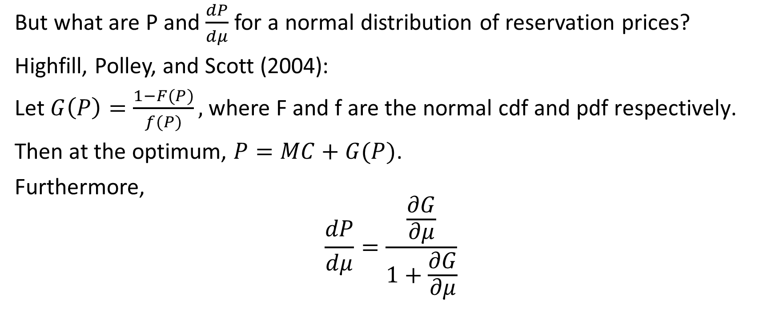
Comparative Statics
But what are P and $\frac{dP}{dμ}$ for a normal distribution of reservation prices?
Highfill, Polley, and Scott (2004):
Let$G\left(P\right)=\frac{1−F(P)}{f(P)}\text{, }\text{where} \text{F} \text{and} \text{f} \text{are} \text{the} \text{normal} \text{cdf} \text{and} \text{pdf} \text{respectively}\text{.}$
Then at the optimum, $P=MC+G(P)$.
Furthermore,
$$\frac{dP}{dμ}=\frac{\frac{∂G}{∂μ}}{1+\frac{∂G}{∂μ}}$$

Slide 18

Implication
For a normal distribution of reservation prices, $\frac{dP}{dμ}$ is approximately equal to market share. (Not a constant as with linear demand.)

Slide 19
Data Analytics
Modern techniques do not necessarily assume a particular functional form for demand.
However, thinking in terms of a distribution of reservation prices (or of consumer types of which reservation prices are a function) is still very useful.
A common technique in analytics is the logistic regression.
We can think about how we might solve a pricing problem using logistic regression.

Slide 20
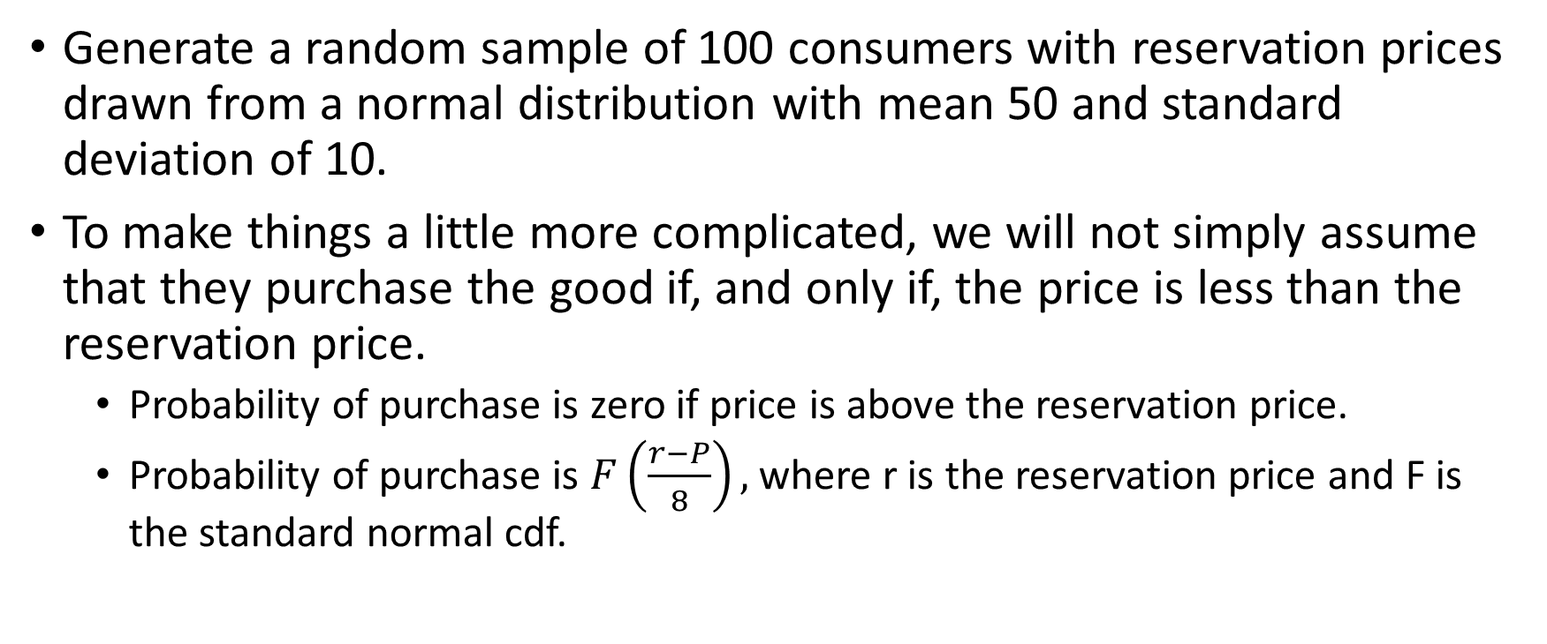
Data Analytics
Generate a random sample of 100 consumers with reservation prices drawn from a normal distribution with mean 50 and standard deviation of 10.
To make things a little more complicated, we will not simply assume that they purchase the good if, and only if, the price is less than the reservation price.
Probability of purchase is zero if price is above the reservation price.
Probability of purchase is $F\left(\frac{r−P}{8}\right),$ where r is the reservation price and F is the standard normal cdf.

Slide 21
Data Analytics
Assume that our price setting firm does not know the distribution a priori and must set their price before customers arrive.
They make an educated guess, and set their price at 50.
Assume zero marginal cost.
The 100 customers arrive and decide whether to buy or not to buy. In the process they reveal their type.
We now have a data set with 100 consumer types (reservation prices) and their decision to buy or not to buy.
Run a logistic regression on this data set.

Slide 22
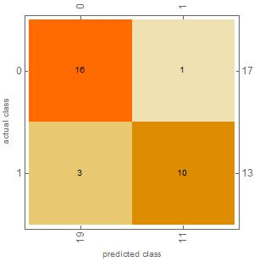
Confusion Matrix

Slide 23
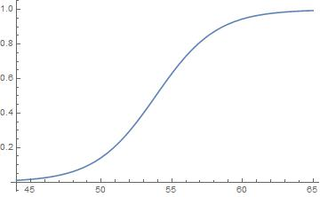
Estimated probability of purchase by different types

Slide 24
Next step
Use the result from the logistic regression to estimate the optimal price.
In this case, we find that the profit maximizing price is 34.

Slide 25
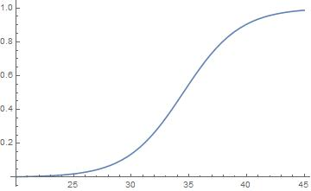
Estimated probability of purchase at the optimal price of 34

Slide 26
How does this compare to Highfill, Polley, and Scott (2004)?
Using their formula, the optimal price would be between 39 and 40.
The difference here is due to the randomness (i.e. that the likelihood of purchase is a function of the difference between price and reservation price).
In fact, if you eliminate the randomness, you get an optimal price of about 39 to 40 just as Highfill, Polley, and Scott (2004) would predict.
However, without the randomness, the logistic regression has essentially a perfect fit! (That’s no fun!)

Slide 27
How does this compare to Highfill, Polley, and Scott (2004)?
If we increase the mean reservation price from 50 to 51, the optimal price goes from 34 to 35 (rounded to the nearerst unit).
Highfill, Polley, and Scott (2004) would suggest an increase of approximately (slightly less) than the market share. In this case, 0.85.
Market share is about 93%.
Again, the difference is due to the randomness, but still it is nowhere near the ½ implied by linear demand approximations.

Slide 28
Conclusion
Pricing is one of the more interesting real-world applications of economics.
Data analytics can provide insight into some interesting and difficult problems and yield results that are comparable to standard theory.

